Slide 1


Variational models
Machine learning for signal processing (5LSL0)
Ruud van Sloun, Rik Vullings,
Nishith Chennakeshava, Hans van Gorp
June 2021

Slide 2
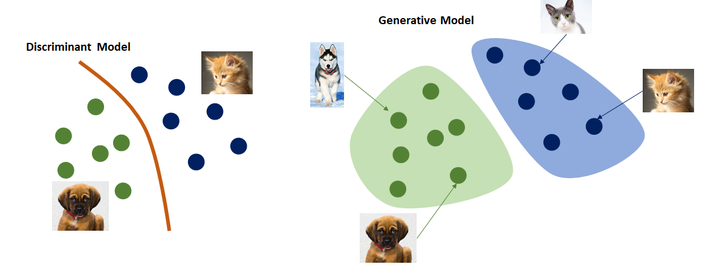
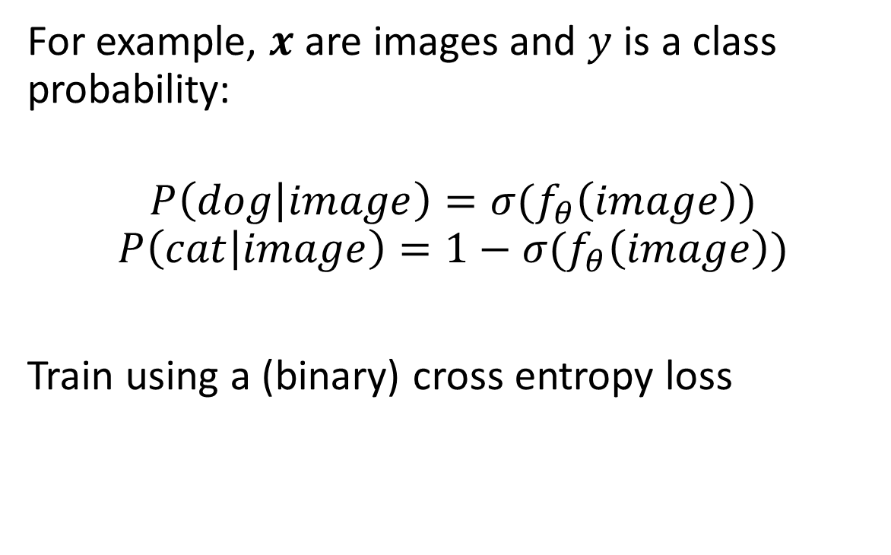
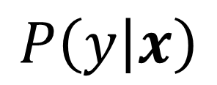
Up until now: Discriminative modeling
$$P\left(y | x\right)$$
For example, $x$ are images and $y$ is a class probability:
$$P\left(dog | image\right)=σ(f_{θ}\left(image\right))$$
$$P\left(cat | image\right)=1−σ(f_{θ}\left(image\right))$$
Train using a (binary) cross entropy loss
Image from:
http://medium.com/@jordi299/about-generative-and-discriminative-models-d8958b67ad32

Slide 3
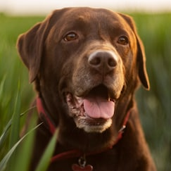
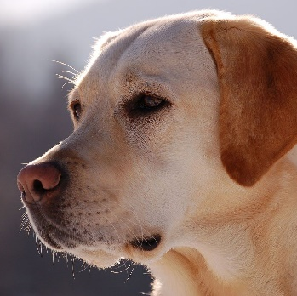
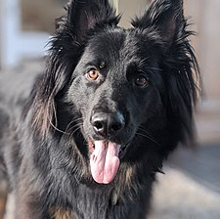
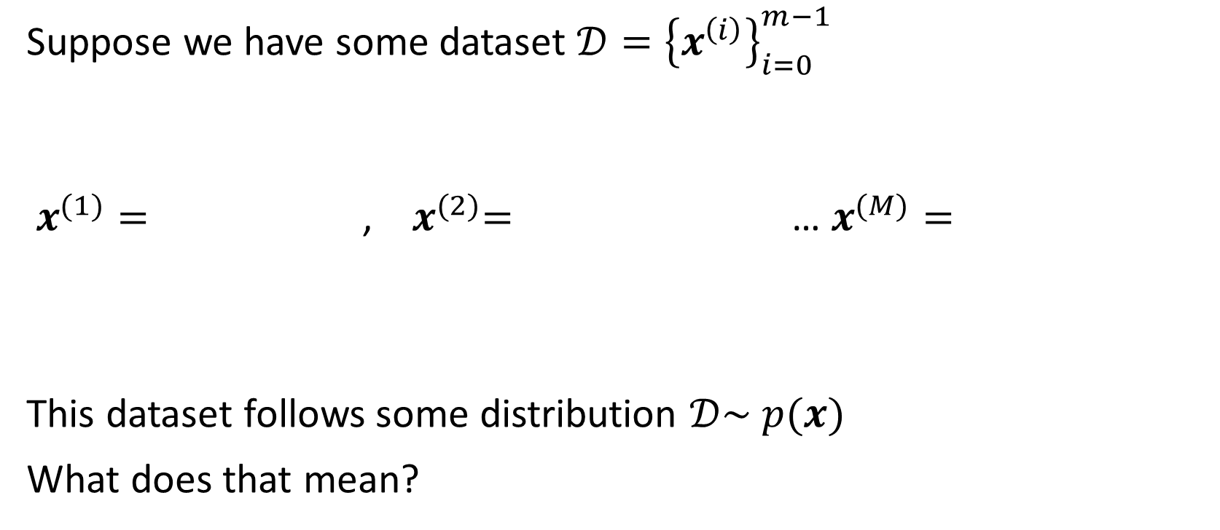
Today: Generative modeling
Suppose we have some dataset $𝒟={\left\{x^{\left(i\right)}\right\}}_{i=0}^{m−1}$
$x^{(1)}=$ , ${ x}^{(2)}=$ … $x^{(M)}=$
This dataset follows some distribution $𝒟\sim p(x)$
What does that mean?

Slide 4



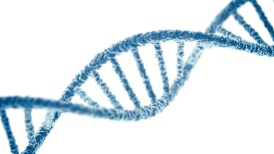
How were these example created?
Process that creates pictures of dogs
Etc.

Slide 5
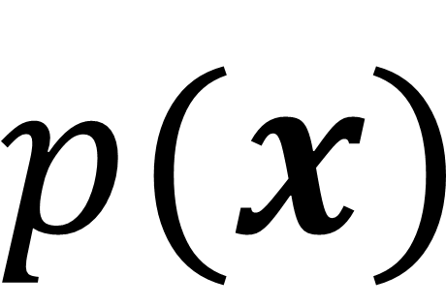
How were these example created?
Process that creates pictures of dogs
$$p(x)$$
Powerful assumption: This process can be captured using a probability distribution

Slide 6
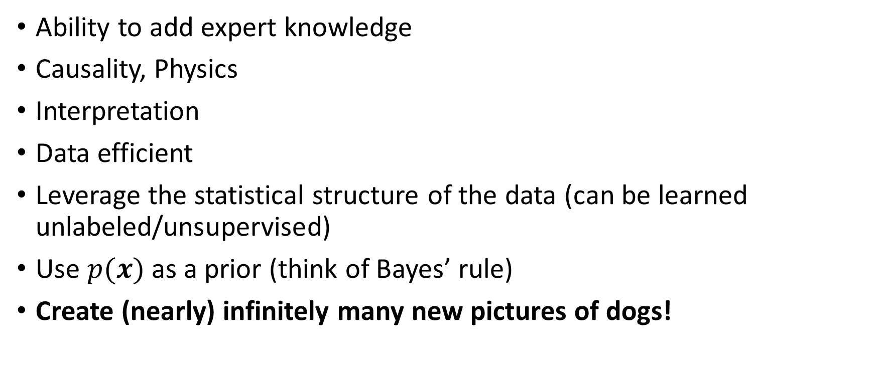

What can we do with knowledge of $p(x)$?
Ability to add expert knowledge
Causality, Physics
Interpretation
Data efficient
Leverage the statistical structure of the data (can be learned unlabeled/unsupervised)
Use $p(x)$ as a prior (think of Bayes’ rule)
Create (nearly) infinitely many new pictures of dogs!

Slide 7
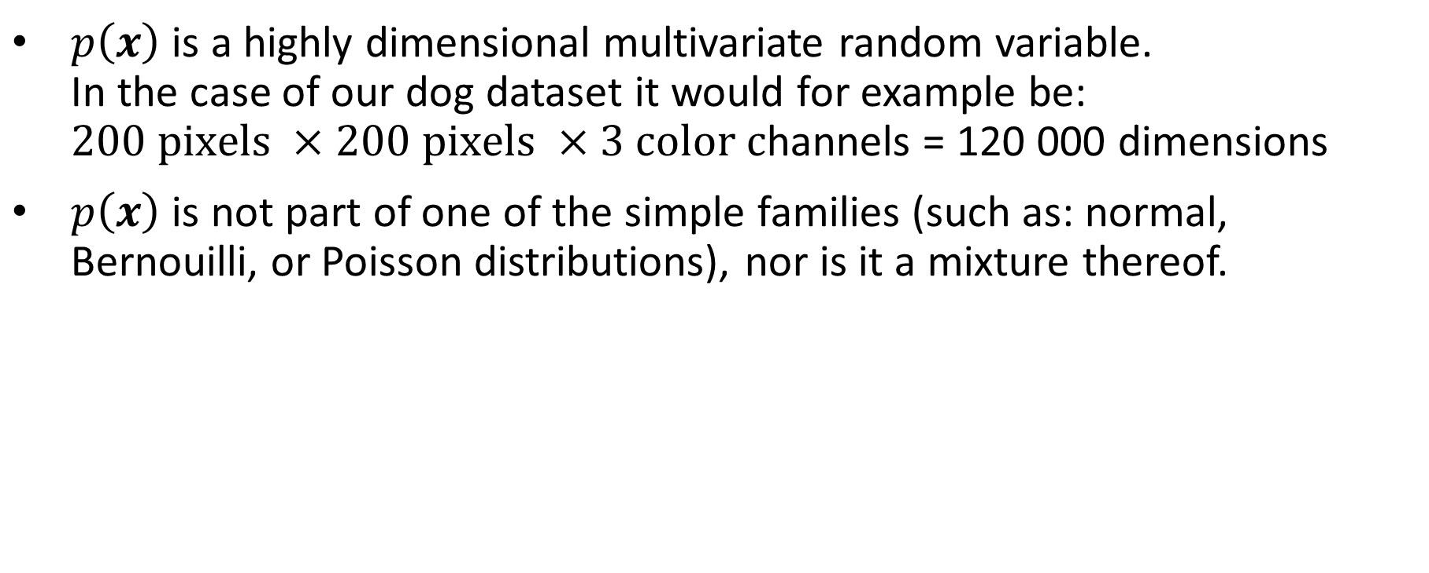

What does $p\left(x\right)$ look like?
$p\left(x\right)$ is a highly dimensional multivariate random variable. In the case of our dog dataset it would for example be: $200 pixels ×200 pixels ×3 color c$hannels = 120 000 dimensions
$p\left(x\right)$ is not part of one of the simple families (such as: normal, Bernouilli, or Poisson distributions), nor is it a mixture thereof.

Slide 8
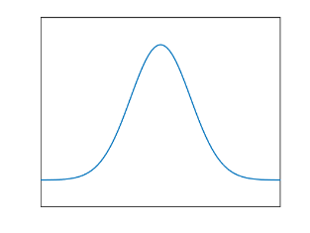
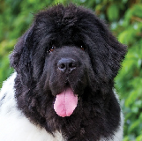
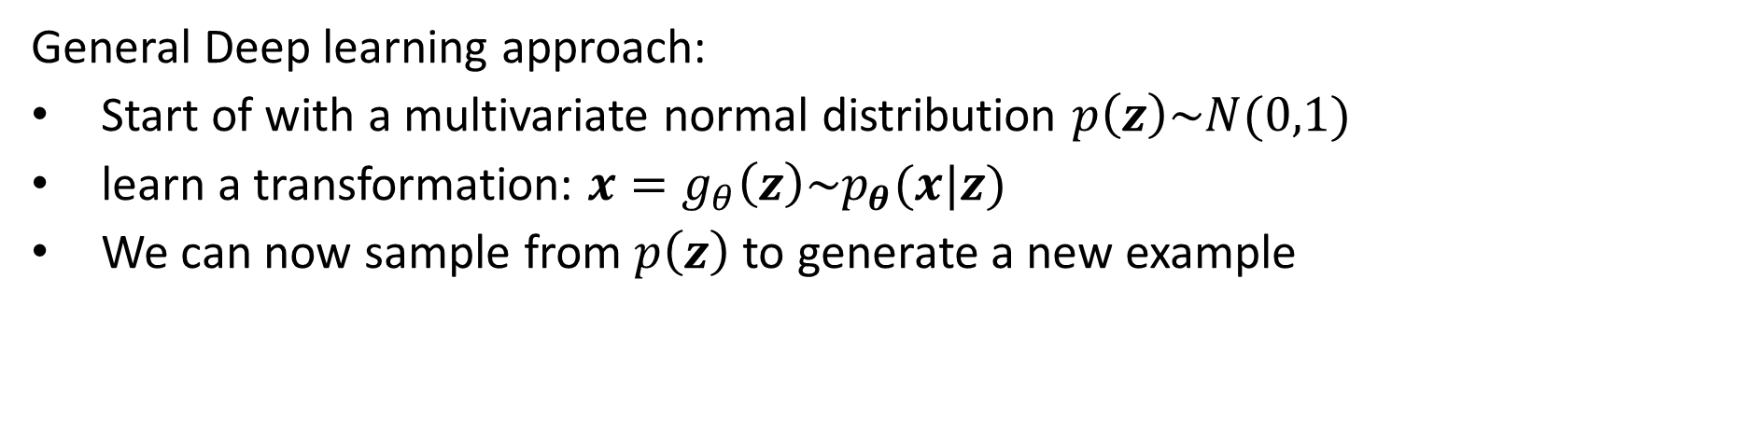
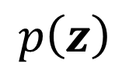
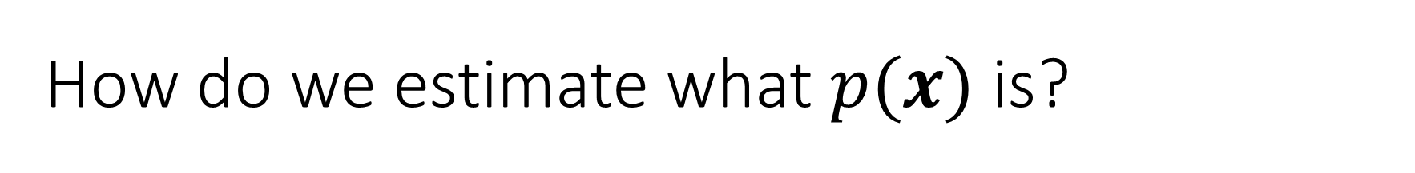
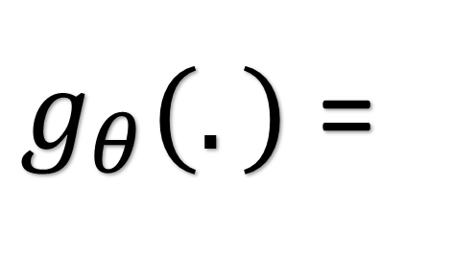
How do we estimate what $p(x)$ is?
General Deep learning approach:
Start of with a multivariate normal distribution $p\left(z\right)\sim N(0,1)$
learn a transformation: ${x=g}_{θ}\left(z\right)\sim p_{θ}(x|z)$
We can now sample from $p\left(z\right)$to generate a new example
$g_{θ}(.)$ =
$$p\left(z\right)$$

Slide 9
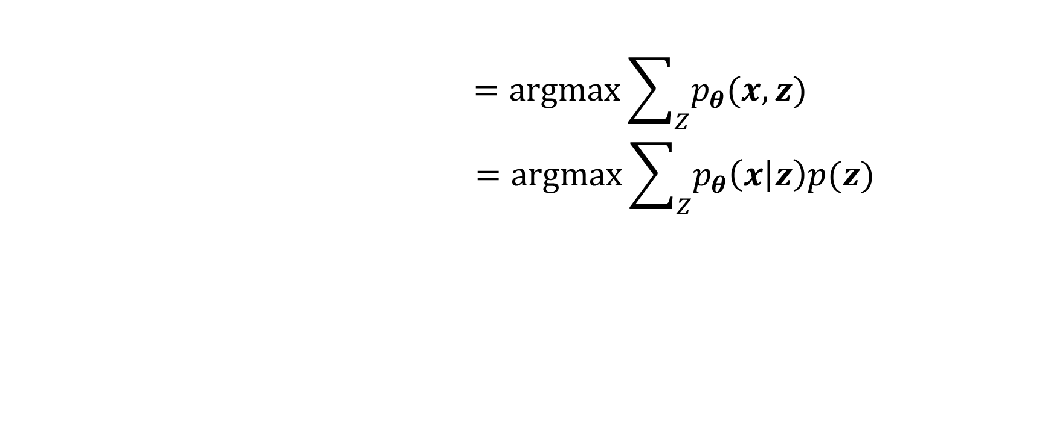
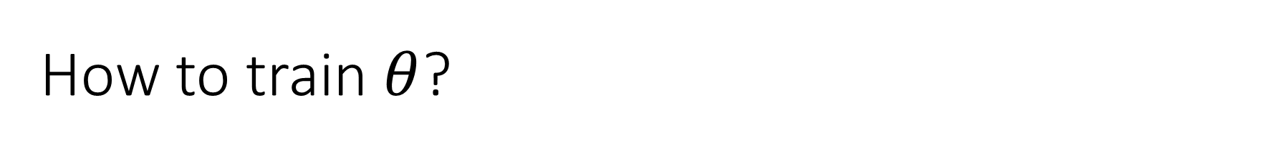
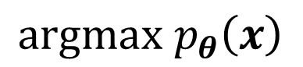
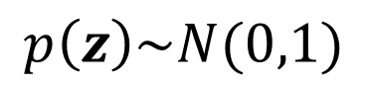
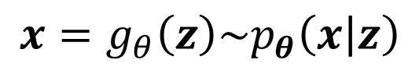
How to train $θ$?
Marginalization over z
$$=argmax\sum_{Z}{p_{θ}(x,z)}$$
$$=argmax\sum_{Z}{p_{θ}\left(x | z\right)p(z)}$$
$$argmax p_{θ}\left(x\right)$$
Chosen freely, e.g., Gaussian
Neural Network
$${x=g}_{θ}\left(z\right)\sim p_{θ}\left(x | z\right)$$
$$p\left(z\right)\sim N(0,1)$$

Slide 10
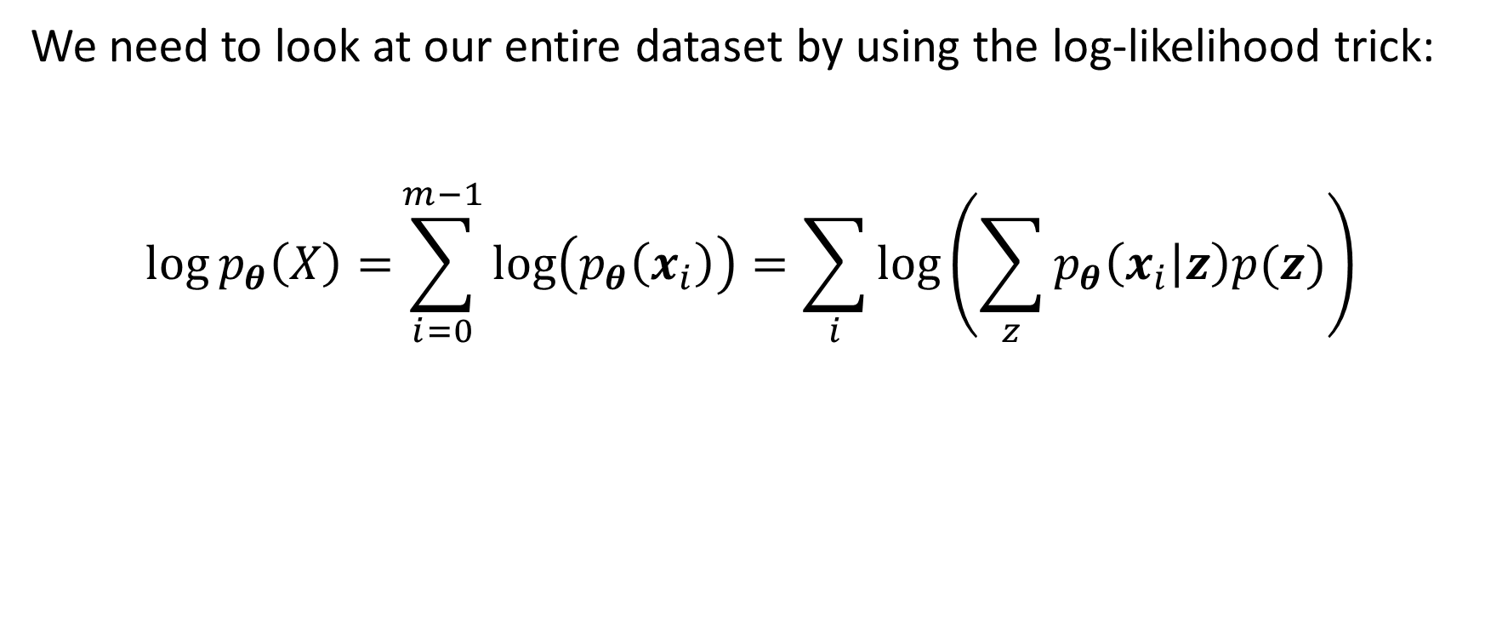
How to train $θ$?
We need to look at our entire dataset by using the log-likelihood trick:
$$\log{p_{θ}\left(X\right)=}\sum_{i=0}^{m−1}{\log\left(p_{θ}\left(x_{i}\right)\right)}=\sum_{i}{\log\left(\sum_{z}{p_{θ}\left(x_{i} | z\right)p(z)}\right)}$$
Typically intractable (e.g., in neural nets)…
Solution: Do not maximize the log-likelihood directly, but rather a (tractable) lower bound of it

Slide 11
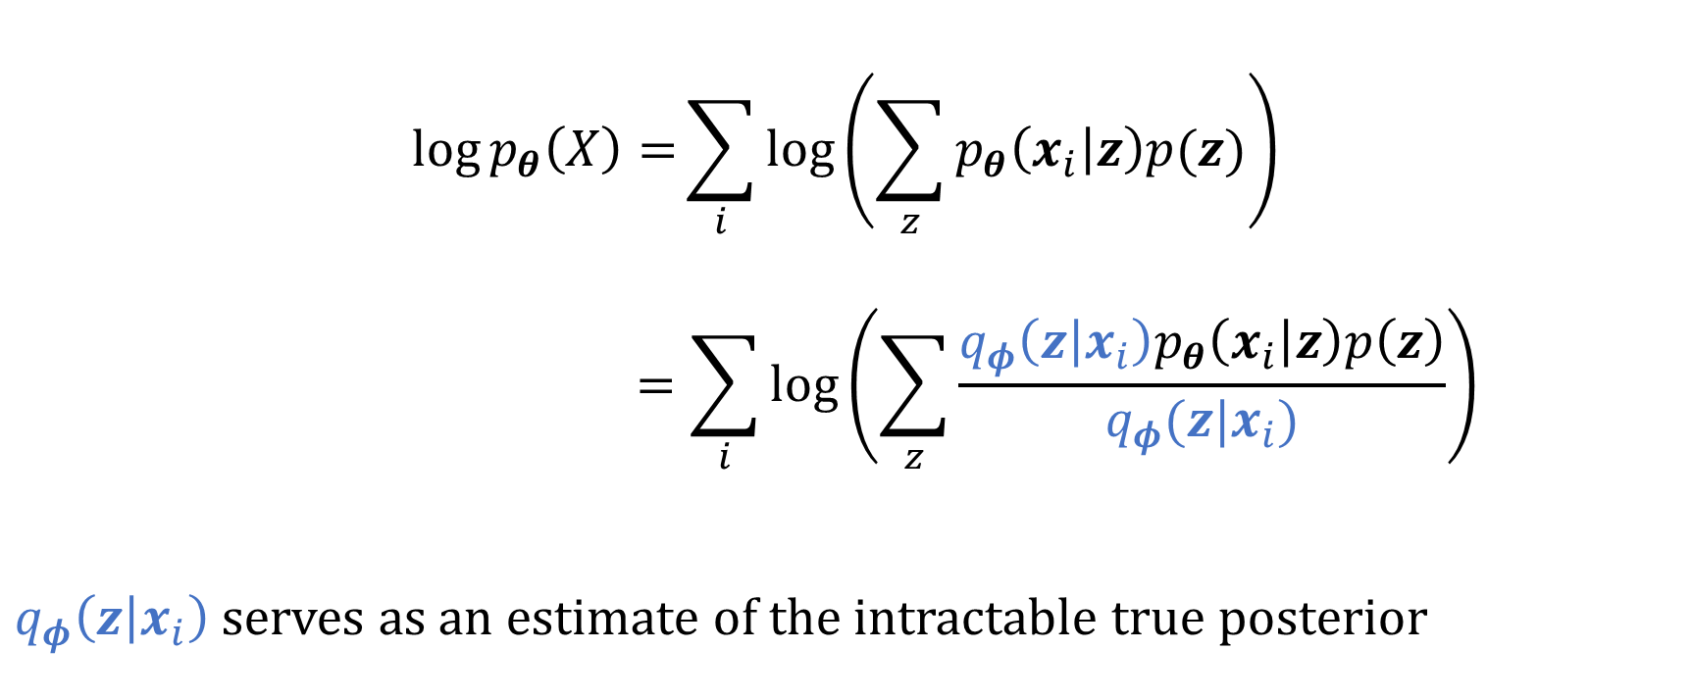
Trick 1, introduce the (estimated) posterior
$$\log{p_{θ}\left(X\right)=}\sum_{i}{\log\left(\sum_{z}{p_{θ}\left(x_{i} | z\right)p(z)}\right)}$$
$$=\sum_{i}{\log\left(\sum_{z}{\frac{q_{φ}\left(z | x_{i}\right)p_{θ}\left(x_{i} | z\right)p\left(z\right)}{q_{φ}(z|x_{i})}}\right)}$$
$q_{φ}\left(z | x_{i}\right)$ serves as an estimate of the intractable true posterior

Slide 12
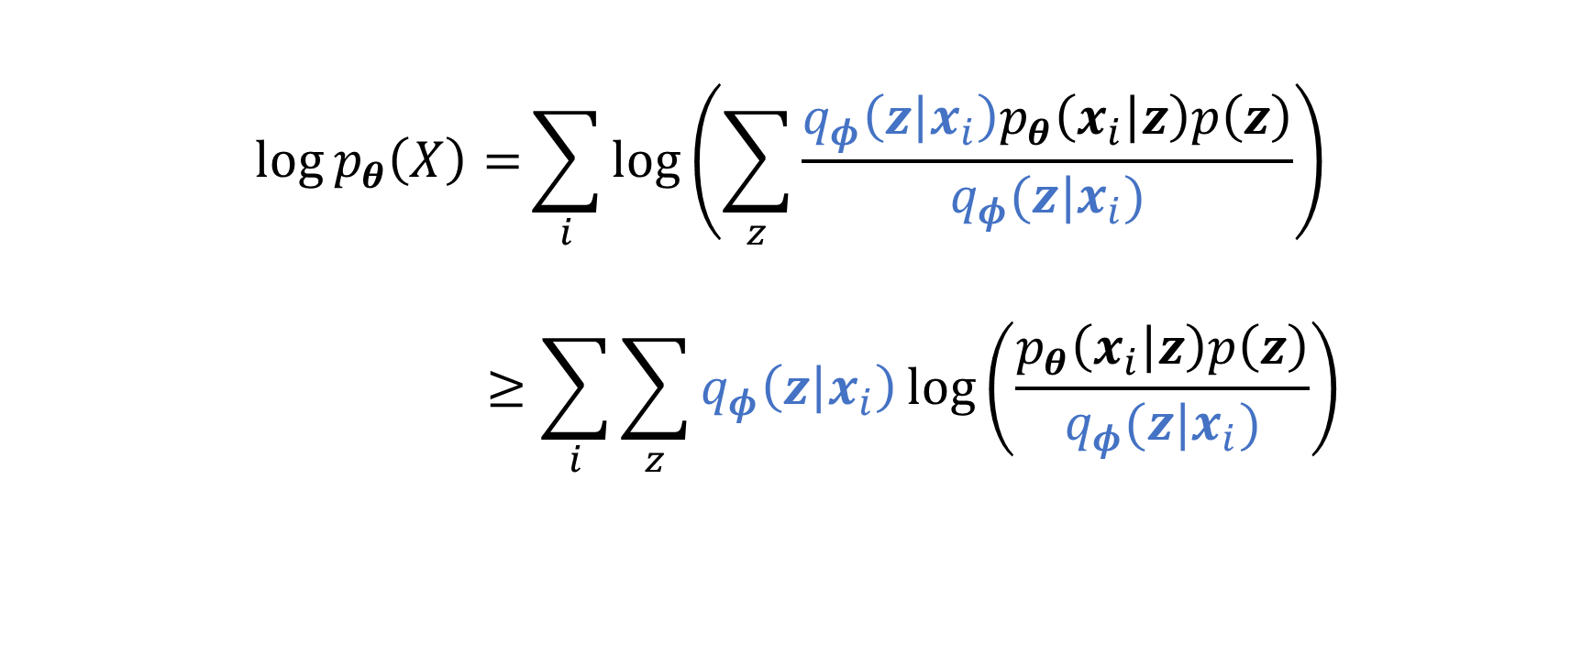
Trick 2, Jensen’s inequality
$$\log{p_{θ}\left(X\right)=}\sum_{i}{\log\left(\sum_{z}{\frac{q_{φ}\left(z | x_{i}\right)p_{θ}\left(x_{i} | z\right)p\left(z\right)}{q_{φ}(z|x_{i})}}\right)}$$
$$≥\sum_{i}{\sum_{z}{q_{φ}\left(z | x_{i}\right)\log\left(\frac{p_{θ}\left(x_{i} | z\right)p\left(z\right)}{q_{φ}(z|x_{i})}\right)}}$$

Slide 13
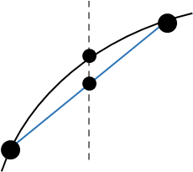
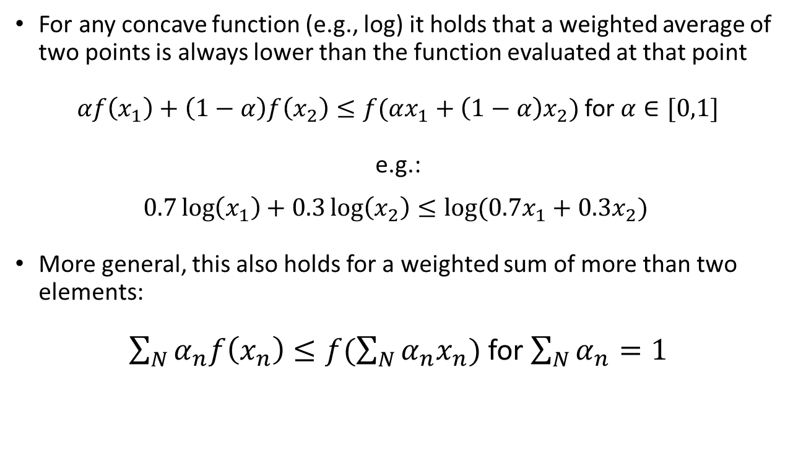
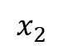
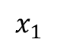
Slight detour: what is Jensen’s inequality?
For any concave function (e.g., log) it holds that a weighted average of two points is always lower than the function evaluated at that point
$αf\left(x_{1}\right)+\left(1−α\right)f\left(x_{2}\right)≤f(αx_{1}+\left(1−α\right)x_{2})$ for $α∈[0,1]$
e.g.:
$$0.7\log\left(x_{1}\right)+0.3\log\left(x_{2}\right)≤\log{(0.7x_{1}+0.3x_{2}) }$$
More general, this also holds for a weighted sum of more than two elements:
$\sum_{N}{α_{n}f\left(x_{n}\right)}≤f(\sum_{N}{α_{n}x_{n}})$ for $\sum_{N}{α_{n}}=1$
$$x_{2}$$
$$x_{1}$$

Slide 14
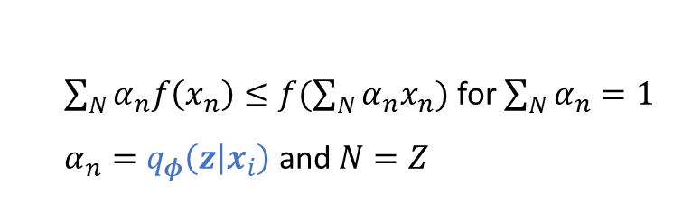
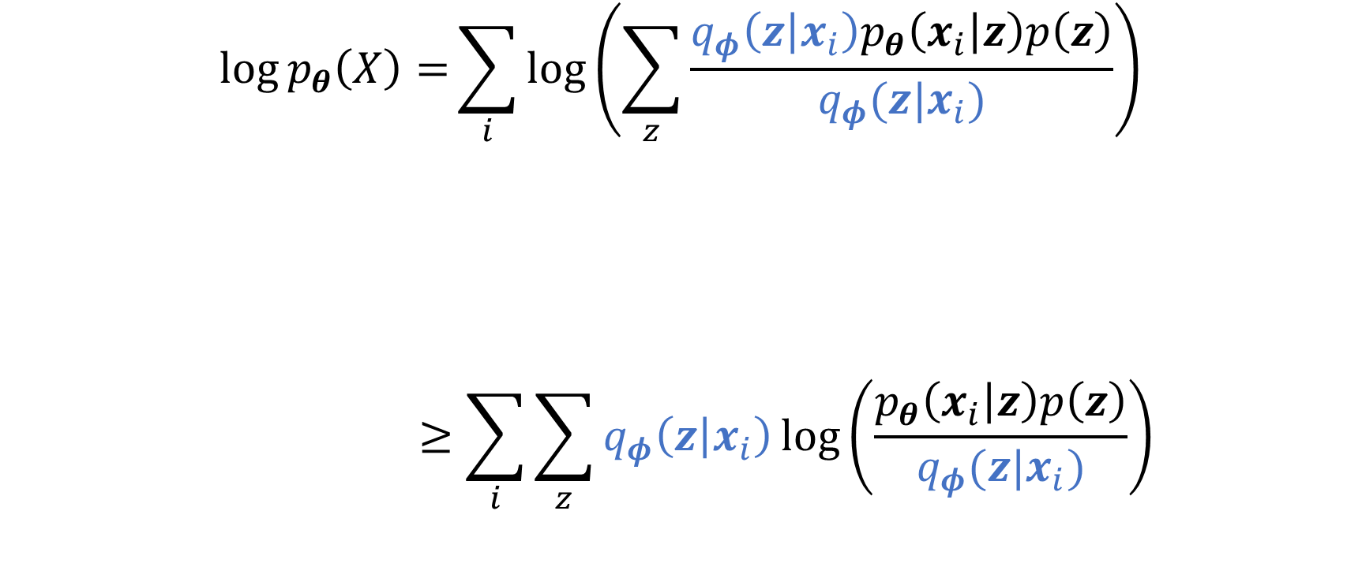
Trick 2, Jensen’s inequality
$$\log{p_{θ}\left(X\right)=}\sum_{i}{\log\left(\sum_{z}{\frac{q_{φ}\left(z | x_{i}\right)p_{θ}\left(x_{i} | z\right)p\left(z\right)}{q_{φ}(z|x_{i})}}\right)}$$
$$≥\sum_{i}{\sum_{z}{q_{φ}\left(z | x_{i}\right)\log\left(\frac{p_{θ}\left(x_{i} | z\right)p\left(z\right)}{q_{φ}(z|x_{i})}\right)}}$$
$\sum_{N}{α_{n}f\left(x_{n}\right)}≤f(\sum_{N}{α_{n}x_{n}})$ for $\sum_{N}{α_{n}}=1$
$α_{n}=q_{φ}\left(z | x_{i}\right)$ and $N=Z$

Slide 15
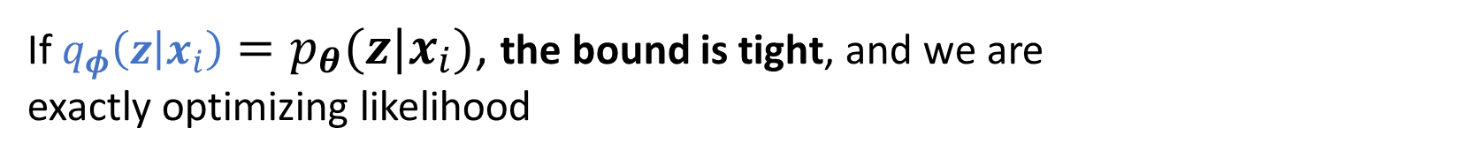
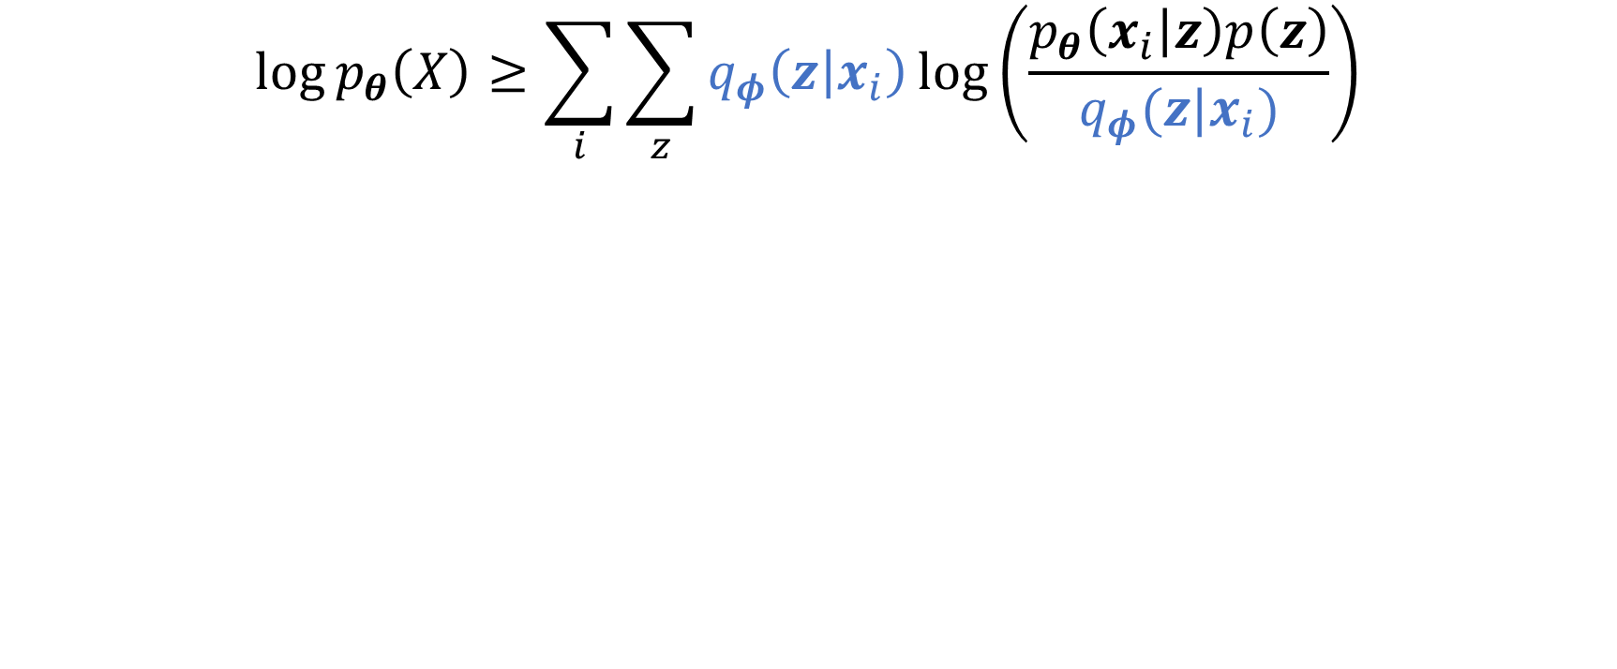
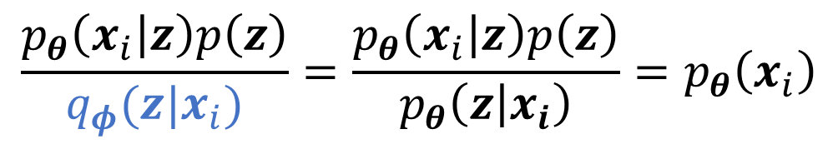
This is the variational lower bound or evidence lower bound (ELBO)
$$\log{p_{θ}\left(X\right)}≥\sum_{i}{\sum_{z}{q_{φ}\left(z | x_{i}\right)\log\left(\frac{p_{θ}\left(x_{i} | z\right)p\left(z\right)}{q_{φ}(z|x_{i})}\right)}}$$
Observation:
If $q_{φ}\left(z | x_{i}\right)=p_{θ}(z|x_{i})$, the bound is tight, and we are
exactly optimizing likelihood
$$\frac{p_{θ}\left(x_{i} | z\right)p\left(z\right)}{q_{φ}(z|x_{i})}=\frac{p_{θ}\left(x_{i} | z\right)p\left(z\right)}{p_{θ}\left(z | x_{i}\right)}=p_{θ}\left(x_{i}\right)$$

Slide 16
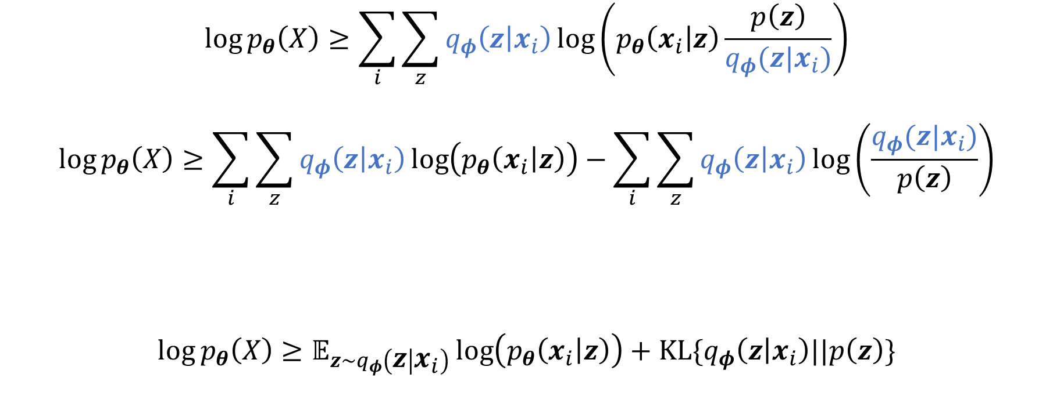
Trick 3, rewrite to KL-divergence
$$\log{p_{θ}\left(X\right)}≥\sum_{i}{\sum_{z}{q_{φ}\left(z | x_{i}\right)\log\left(p_{θ}\left(x_{i} | z\right)\frac{p\left(z\right)}{q_{φ}(z|x_{i})}\right)}}$$
$$\log{p_{θ}\left(X\right)}≥\sum_{i}{\sum_{z}{q_{φ}\left(z | x_{i}\right)\log\left(p_{θ}\left(x_{i} | z\right)\right)}}−\sum_{i}{\sum_{z}{q_{φ}\left(z | x_{i}\right)\log\left(\frac{q_{φ}(z|x_{i})}{p\left(z\right)}\right)}}$$
$$\log{p_{θ}\left(X\right)}≥𝔼_{z\sim q_{φ}\left(z | x_{i}\right)}\log\left(p_{θ}\left(x_{i} | z\right)\right)+KL\{q_{φ}\left(z | x_{i}\right)||p\left(z\right)\}$$
We can view the sums as an expectation

Slide 17
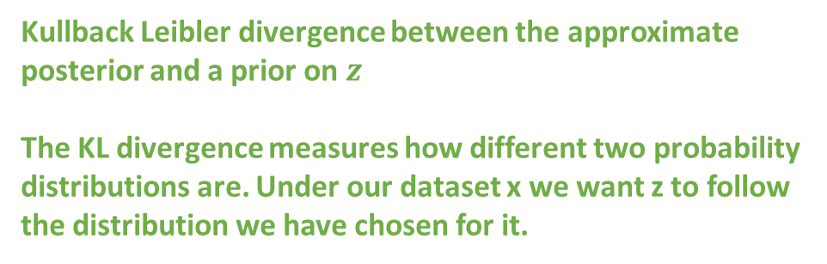
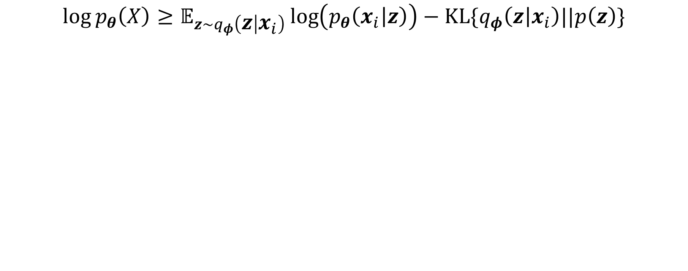
Trick 3, rewrite to KL-divergence
$$\log{p_{θ}\left(X\right)}≥𝔼_{z\sim q_{φ}\left(z | x_{i}\right)}\log\left(p_{θ}\left(x_{i} | z\right)\right)−KL\{q_{φ}\left(z | x_{i}\right)||p\left(z\right)\}$$
Regular maximum likelihood
objective for training autoencoders
(e.g. Gaussian, Bernoulli, …)
Kullback Leibler divergence between the approximate posterior and a prior on $z$
The KL divergence measures how different two probability distributions are. Under our dataset x we want z to follow the distribution we have chosen for it.

Slide 18
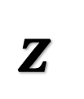
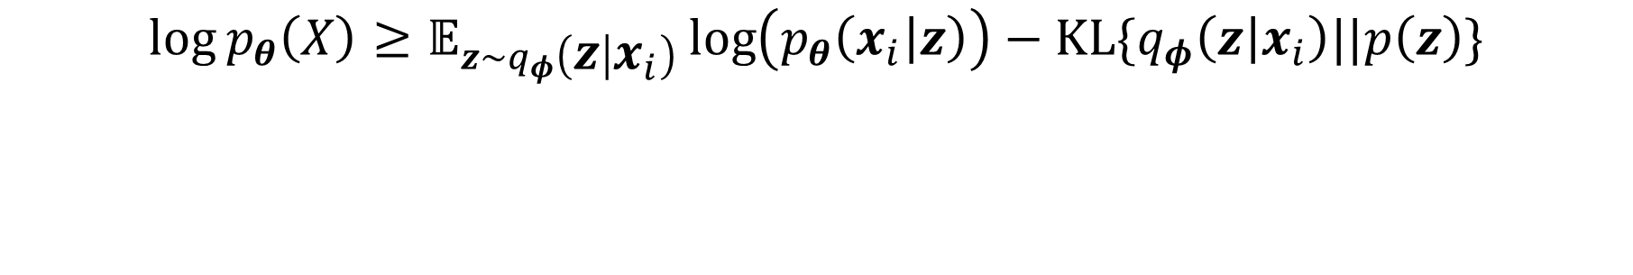


Variational AutoEncoder (VAE)
Encoder
$$z$$
Decoder
$$q_{φ}\left(z | x_{i}\right)$$
$$p_{θ}\left(x_{i} | z\right)$$
$$\log{p_{θ}\left(X\right)}≥𝔼_{z\sim q_{φ}\left(z | x_{i}\right)}\log\left(p_{θ}\left(x_{i} | z\right)\right)−KL\{q_{φ}\left(z | x_{i}\right)||p\left(z\right)\}$$
The output should look like the input
The z generated by the encoder should follow a predefined distribution. e.g., a Gaussian

Slide 19
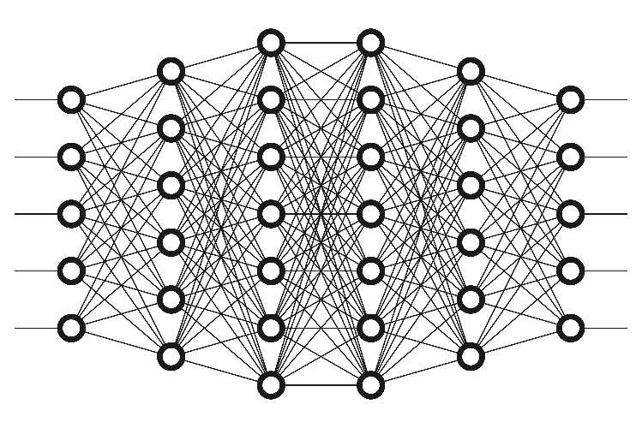
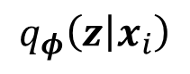
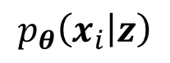
Variational AutoEncoder (VAE)
Encoder
Decoder
$$z$$
$$q_{φ}\left(z | x_{i}\right)$$
$$p_{θ}\left(x_{i} | z\right)$$
Question: if the encoder and decoder are Neural Nets, how do we introduce randomness?

Slide 20

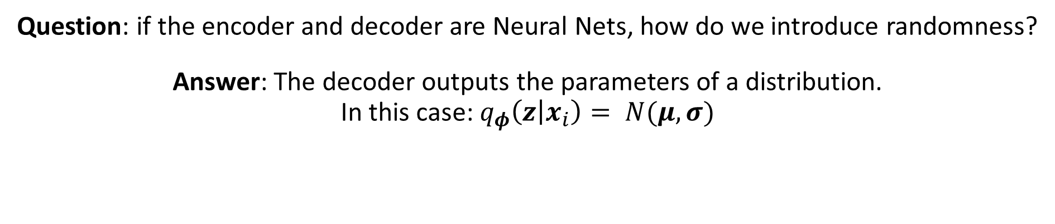
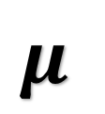
Variational AutoEncoder (VAE)
Encoder
$$μ$$
Decoder
Sample
$$σ$$
$$q_{φ}\left(z | x_{i}\right)$$
$$p_{θ}\left(x_{i} | z\right)$$
Question: if the encoder and decoder are Neural Nets, how do we introduce randomness?
Answer: The decoder outputs the parameters of a distribution.
In this case: $q_{φ}\left(z | x_{i}\right)= N(μ,σ)$

Slide 21
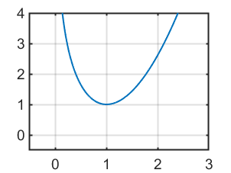
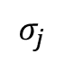
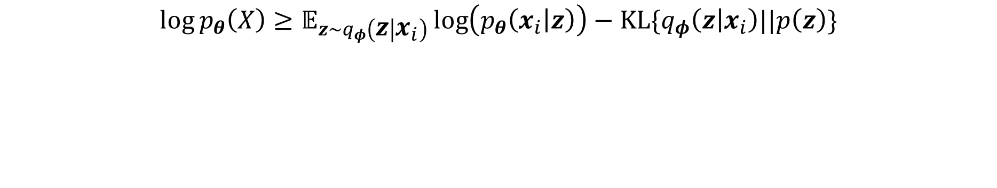
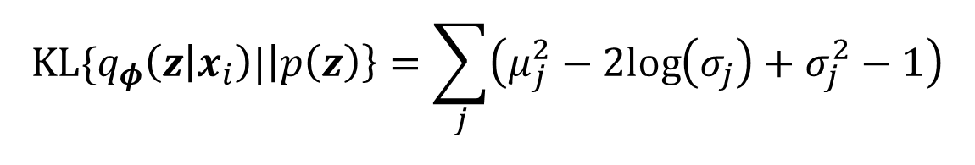
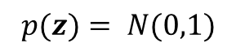
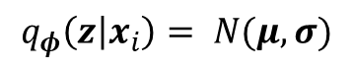

Variational AutoEncoder (VAE)
Encoder
$$μ$$
Decoder
Sample
$$σ$$
$$q_{φ}\left(z | x_{i}\right)$$
$$p_{θ}\left(x_{i} | z\right)$$
$$\log{p_{θ}\left(X\right)}≥𝔼_{z\sim q_{φ}\left(z | x_{i}\right)}\log\left(p_{θ}\left(x_{i} | z\right)\right)−KL\{q_{φ}\left(z | x_{i}\right)||p\left(z\right)\}$$
$$q_{φ}\left(z | x_{i}\right)= N(μ,σ)$$
$$p(z)= N(0,1)$$
$$KL$$
$$KL\{q_{φ}\left(z | x_{i}\right)|\left|p\left(z\right)\right\}=\sum_{j}{\left(μ_{j}^{2}−2log\left(σ_{j}\right)+σ_{j}^{2}−1\right)}$$
$$σ_{j}$$
Sum across the dimensions of the latent space

Slide 22
Variational AutoEncoder (VAE)
Encoder
$$μ$$
Decoder
Sample
$$σ$$
$$q_{φ}\left(z | x_{i}\right)$$
$$p_{θ}\left(x_{i} | z\right)$$
Question: if we sample in the bottleneck, how do we backprop to the encoder?
Answer: Perform the re-parameterization trick

Slide 23







Trick 4, re-parameterization
Encoder
Decoder
$$μ$$
$$μ+σ∙ε$$
$$σ$$
$$q_{φ}\left(z | x_{i}\right)$$
$$ε$$
$$p_{θ}\left(x_{i} | z\right)$$
In this case $z=μ+σ∙ε$
$ε\sim N(0,1)$ and $z\sim N(μ,σ)$.
Check this for yourself

Slide 24


Trick 4, re-parameterization
Encoder
Decoder
$$μ$$
$$μ+σ∙ε$$
Backprop
$$σ$$
$$q_{φ}\left(z | x_{i}\right)$$
$$ε$$
$$p_{θ}\left(x_{i} | z\right)$$
Backprop is now possible, as we can just sample $ε$ during the forward pass, and view at as a constant during backprop.
$$\log{p_{θ}\left(X\right)}≥𝔼_{z\sim q_{φ}\left(z | x_{i}\right)}\log\left(p_{θ}\left(x_{i} | z\right)\right)−KL\{q_{φ}\left(z | x_{i}\right)||p\left(z\right)\}$$
Effectively we are getting the expectation through Monte-Carlo

Slide 25


In practice how do you go about one training example?
$μ, σ=encoder_{φ}\left(x\right)$
draw one sample of $ε\sim N\left(0,1\right)$
Calculate $z=μ+σ∙ε$
$\hat{x}=decoder_{θ}\left(z\right)$
$−𝔼_{z\sim q_{φ}\left(z | x_{i}\right)}\log\left(p_{θ}\left(x_{i} | z\right)\right)=mse(\hat{x},x)$
$KL\{q_{φ}\left(z | x_{i}\right)|\left|p\left(z\right)\right\}=\sum_{j}{\left(μ_{j}^{2}−2log\left(σ_{j}\right)+σ_{j}^{2}−1\right)}$
$𝓛oss=mse\left(\hat{x},x\right)+\sum_{j}{\left(μ_{j}^{2}−2log\left(σ_{j}\right)+σ_{j}^{2}−1\right)}$
Assuming a Gaussian error

Slide 26




Generating new data
Decoder
$$z=ε$$
$$ε$$
$$p_{θ}\left(x_{i} | z\right)$$
To generate new data, we only need the decoder, and we can simply directly inject $ε$, which is often then directly called $z$

Slide 27




We can do some fancy stuff
Decoder
$$z=ε$$
$$ε$$
$$p_{θ}\left(x_{i} | z\right)$$
Resulting x when sampling z on a 2D grid

Slide 28


Interpolating the latent space…
Smiling?
Glasses?
https://houxianxu.github.io/assets/project/dfcvae

